Slide 1
Software Quality Assurance and Testing
USING UFT TO TEST MERCURY TOURS WEBSITE

Slide 2
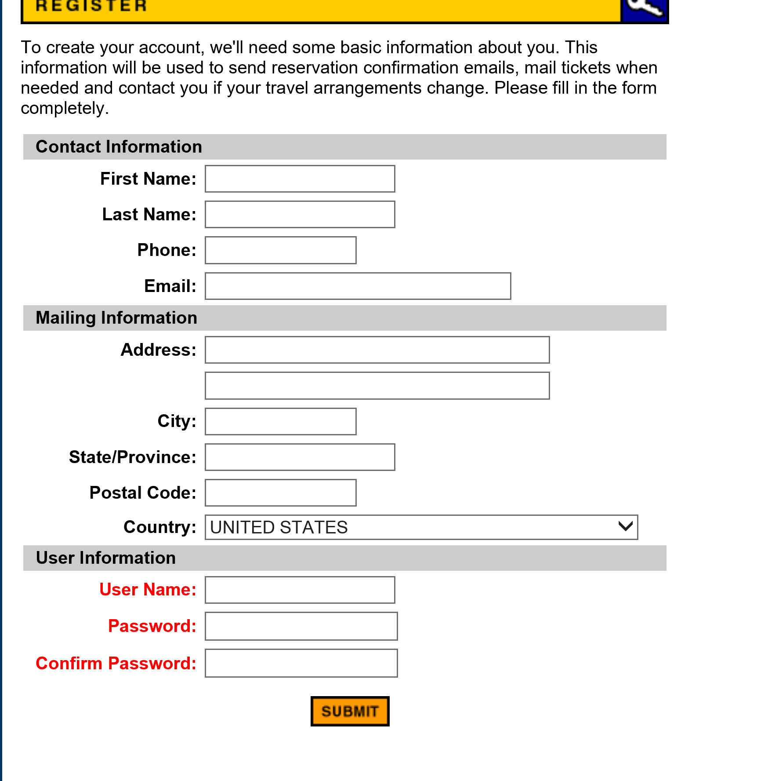
REGISTRATION PAGE

Slide 3
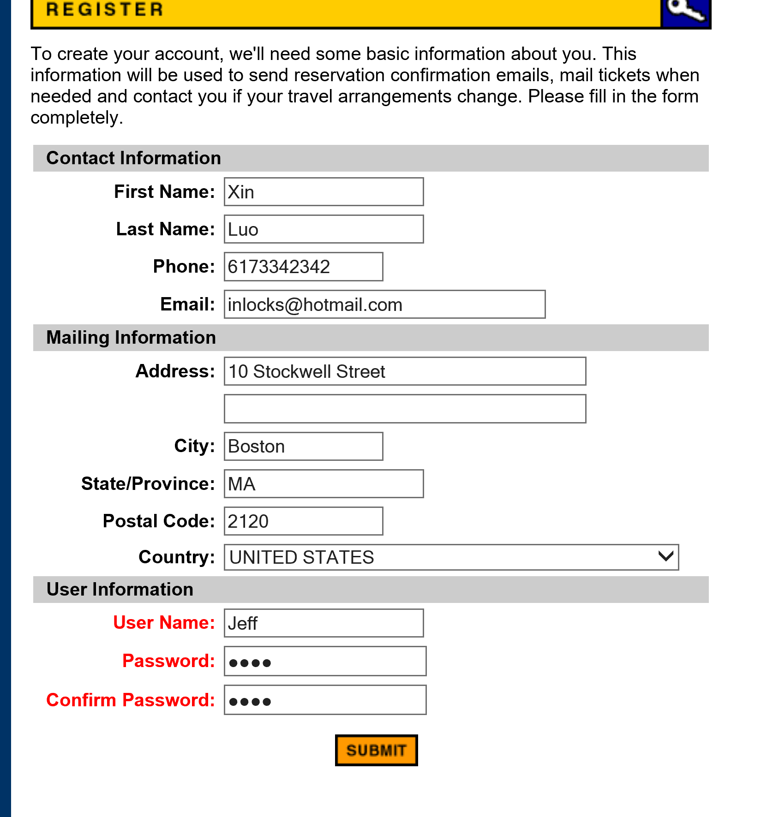
REGISTERING THE SUCCESSFUL USER

Slide 4
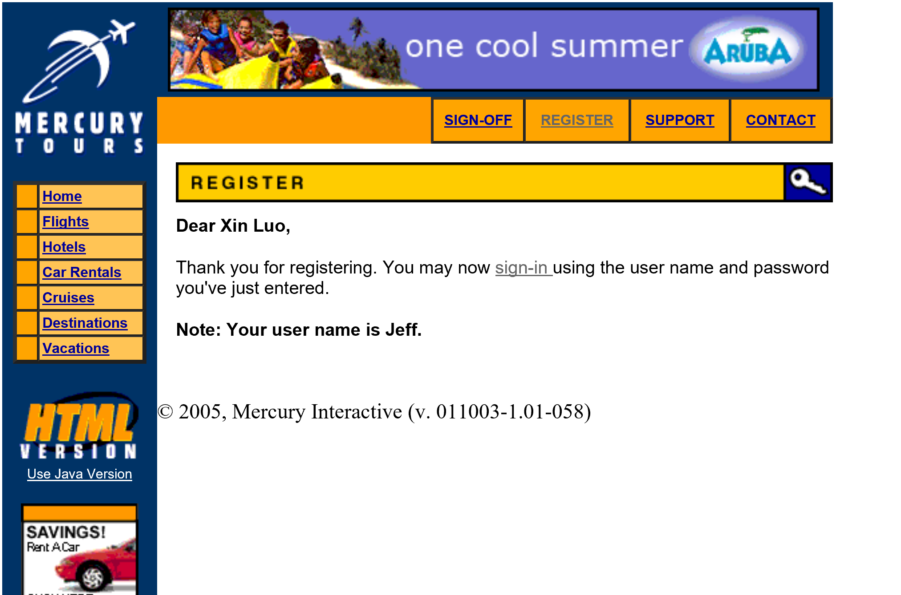
USER SUCCESSFULLY REGISTERED

Slide 5
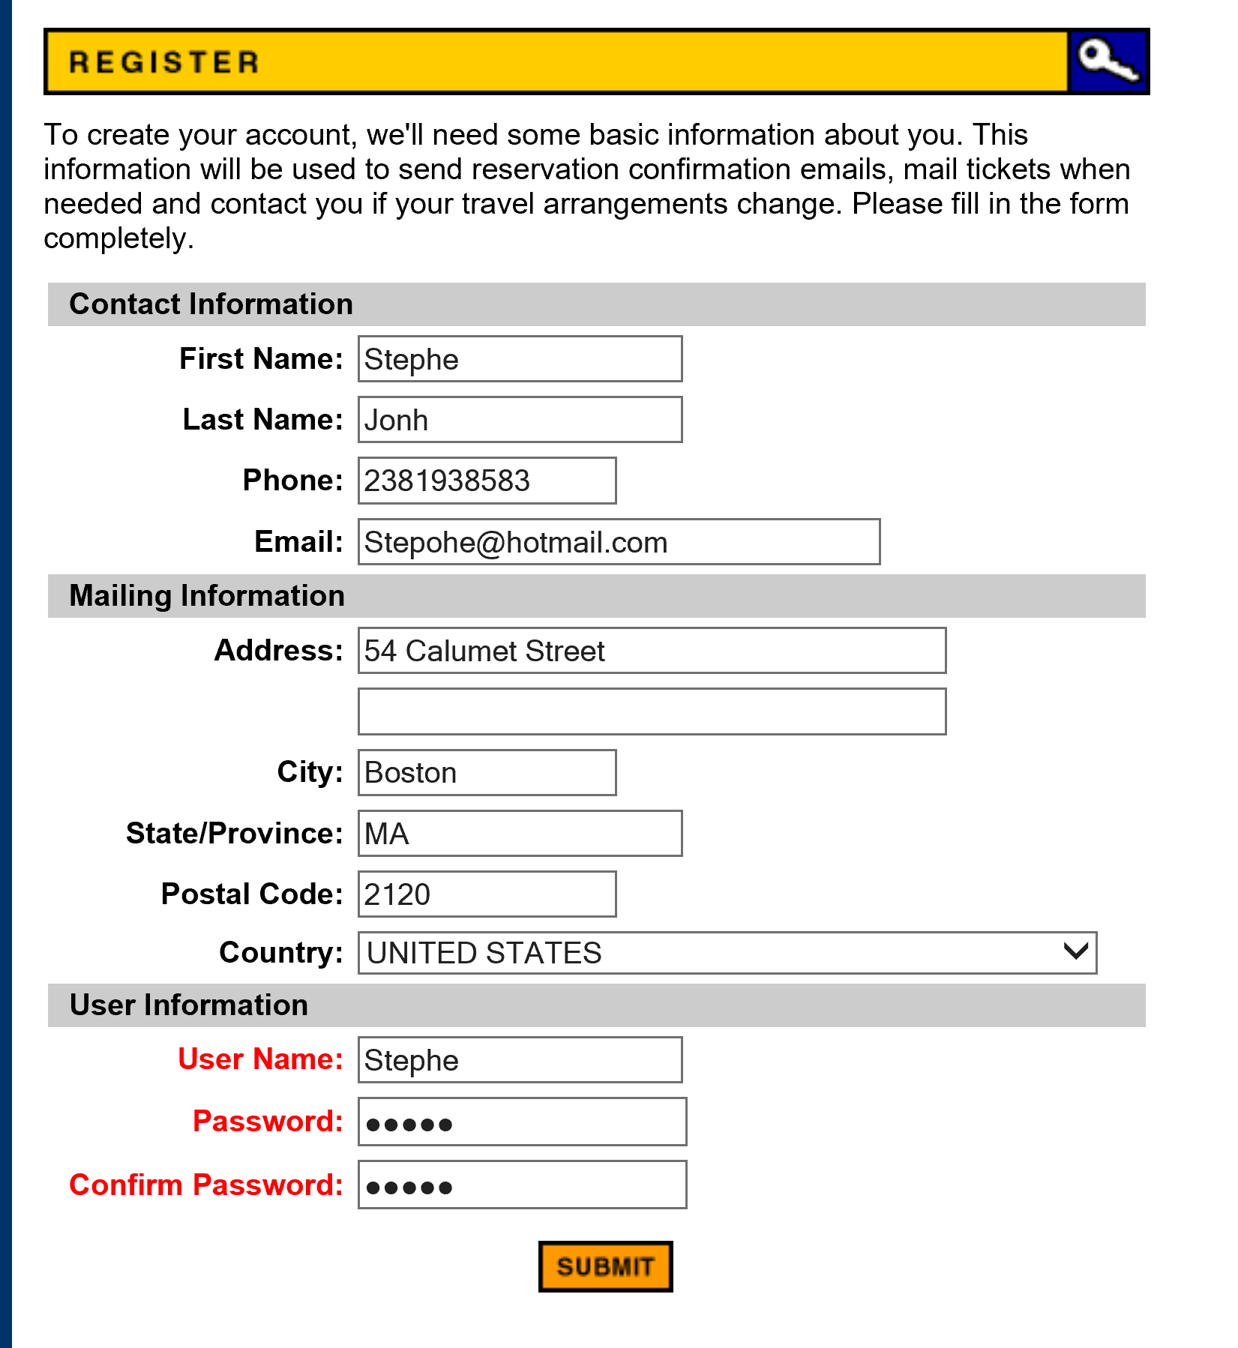
NEGATIVE SCENARIO 1

Slide 6
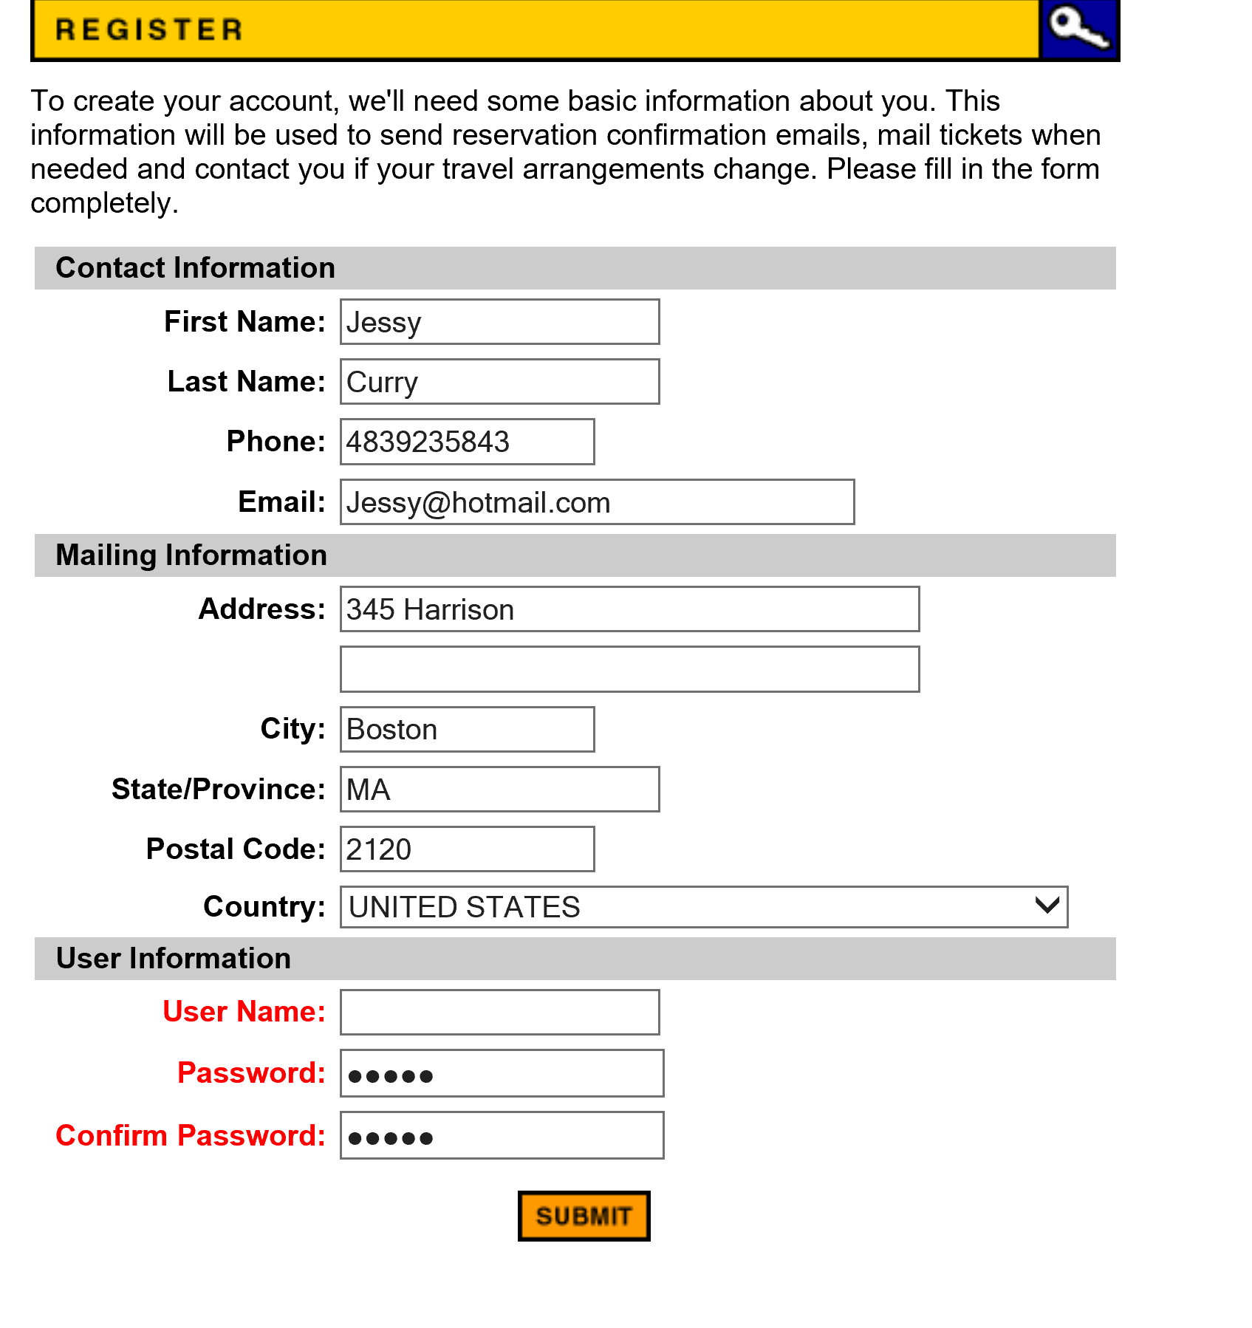
NEGATIVE SCENARIO 2

